Slide 1
Peace Coexistence, Resilience & Tolerance
By
Dr.Usman Rasheed Chaudhry
Wellbeing Consultant

Slide 2
DEFINITIONS
Peace is a concept of friendship and harmony in the absence of hostility and violence between individuals, groups and nations
Peace can mean either 'harmony', 'order', 'justice' or 'conflict management'.
Resilience is the psychological quality that allows some people to be knocked down by the adversities of life and come back at least as strong as before.
It is capacity of a group, community, or society at large to cope with stresses and disturbances as a result of social, political, and environmental change and to adjust while still retaining essentially the same functions by the people

Slide 3
Definitions
Tolerance is a powerful word. It represents a set of values that we as a society hope to follow, conveying inclusion, openness and respect, and encouraging acceptance of others. It is a virtue that many aspire to as it creates a world where discrimination is obsolete.

Slide 4
Johan Galtung Father of Peace Studies
According to Johan Galtung peace is the absence of fear, hatred, and oppression. It is a state of being in which people can live their lives with dignity, respect, and equality. Peace is not simply the absence of conflict, but the presence of justice, democracy, and human rights.
Johan mentioned two types of peace Negative and Positive peace.

Slide 5
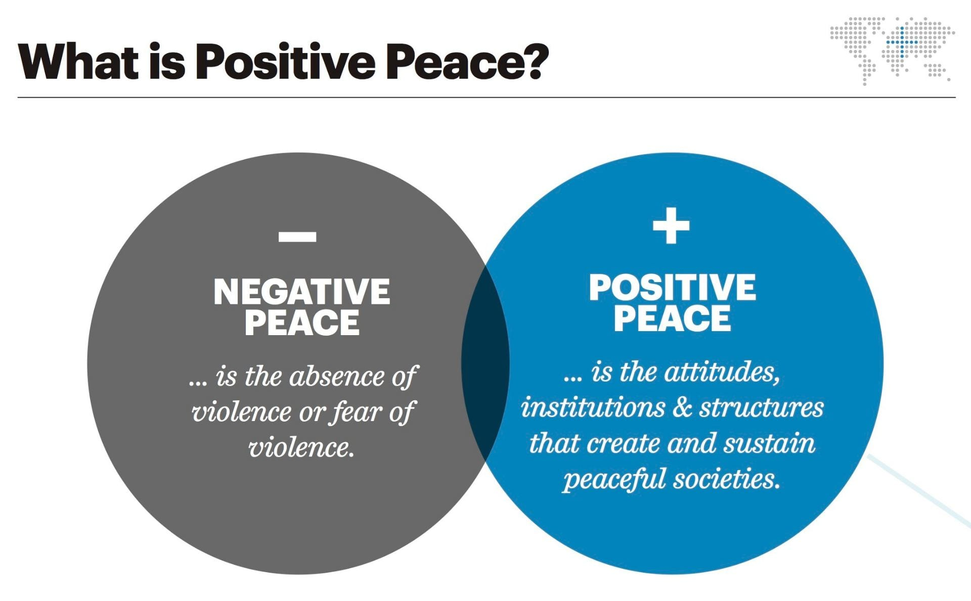
Two types of Peace

Slide 6
Negative & Positive Peace
Negative peace: Absence of violence, pessimistic,curative,peace not always by peaceful means
Positive peace: Structural integration, optimistic,preventive,peace by peaceful means.

Slide 7
Importance of Violence in peace coexistence
Violence of every kind is the greatest challenge to peace. . Violence can be of different forms, intensity and extension.
Violence is defined as avoidable insults to basic human needs and more generally to life.

Slide 8
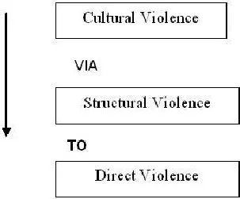
Flow of Violence

Slide 9
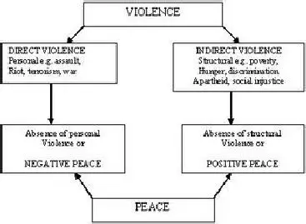
Violence ,Negative and Positive Peace

Slide 10
Peace coexistence status in Pakistan
Pakistan is South Asian country suffered from series of conflict in recent years ,linked to instability in Afghanistan, the global war on terror ,regional tension and violent internal political unrest.

Slide 11
Factors important for peace coexistence in Pakistan
political will
National peace building Plan
Involvement of all stake holders in social cohesion and peace building
Respect for all religions and ethnic groups
Same education plan for all(formative phase for personal development)
Positive role of Media in peace building

Slide 12
As a Teacher How to promote peace coexistence , resilience and tolerance
Personal Development
Mental Toughness 4 C’s
Positive Communication styles
Sense of Ownership
Participatory role in peace building
Maximum utilization from available resources
Problem solver instead of problem teller.
The Golden Rule "treat others the way you want to be treated." This concept needs to be propagated.

Slide 13
Main pillars of Peace coexistence ,resilience and tolerance
Better Quality of life
Peace building Awareness & peace education programs
Involvement of local Intelligentsia
Equality for all
Approachable governance
Personal development(conflict management , anger management ,)
Media program on social cohesion and peace building.
Well-functioning government..
Free flow of information.
Good relations with neighbors.
High levels human capital which increases life expectancy and increases literacy.
Acceptance of the rights of others.

Slide 14
Words to Ponder
Never fear to communicate
&
Never communicate out of fear

